Slide 1

Speech Emotion Recognition with librosa Python
Team Members: -
MTV Soumith (2010030097)
C.Koushik Reddy(2010030027)
D.Chaitanya(2010030045)
TSS Subramanyam(2010030167)

Slide 2
Abstract
Emotion recognition is a rapidly growing research domain in recent years. Unlike humans, machines lack the abilities to perceive and show emotions.
But human-computer interaction can be improved by automated emotions recognition, thereby reducing the need of human intervention. In this project, we are going to implement four basic emotional speech signals (Anger, Happy, Fear and Neutral).

Slide 3
INTRODUCTION
Human computer interaction will be natural and effective when the interfaces are sensitive to human emotion or stress. Previous studies were mainly focused on facial emotion recognition, but speech emotion detection is gaining importance due its wide range of applications. Speech emotion recognition still remains a challenging task in the field of affective computing as no defined standards exist for emotion classification. Speech signal carries large information related to the emotions conveyed by a person. Speech recognition system fails miserably if robust techniques are not implemented to address the variations in speech due to emotion. Emotion detection from speech has two main steps. They are feature extraction and classification. The goal of this project is to give an overview on the types of corpus, features and classification techniques that are associated with speech emotion recognition.

Slide 4
WIP
In the previous review we just explained about our problem statement. But in this review we have started our implementation . First we installed libraries like librosa soundfile , numpy , sklearn, pyaudio by pip install library name . Also we have collected by giving some basic images of different emotions like happy , sad , frighten.. Etc . And then we have created python files for creating datasets and detecting image and audio . Also we have given an customized input by giving our own images with different
Expressions. Also we would like to add some other different expressions like shocked hesitated and surprised feeling . Also we would like to improve image quality by reducing the noise also the audio
quality

Slide 5
Data Set
For this Python mini project, we’ll use the RAVDESS dataset; this is the Ryerson Audio-Visual Database of Emotional Speech.
This dataset has 7356 files rated by 247 individuals 10 times on emotional validity, intensity, and genuineness. The entire dataset is 24.8GB from 24 actors.

Slide 6
Flowchart
No
Code error
Change the data
Start
Image/audio
No
Check whether all the labels are present or not
Train the data
Data valid or not
Yes
Create a Dataset
Yes
Check the data
NN Classification
Image Processing
Feature extraction
No
Error Code/Image
Create by custom dataset or Predefined dataset
No
Speech/Image Recognition
Recognised
End
Yes

Slide 7
Implementation
Step-1 Creating dataset
Libraries we used :
numpy
Opencv
mutils
math
We have to import these libraries by adding some packages

Slide 8
Code
def create_dataset_folders(dataset_path, labels): for label in labels: dataset_folder = dataset_path + "\\" + label if not os.path.exists(dataset_folder): os.makedirs(dataset_folder) def detect_face(frame, faceNet, threshold=0.5): global detections (h, w) = frame.shape[:2] blob = cv2.dnn.blobFromImage(frame, 1.0, (300, 300), (104.0, 177.0, 123.0)) faceNet.setInput(blob) detections = faceNet.forward() locs = [] for i in range(0, detections.shape[2]): confidence = detections[0, 0, i, 2] if confidence > threshold: box = detections[0, 0, i, 3:7] * np.array([w, h, w, h]) (startX, startY, endX, endY) = box.astype("int") return (locs) def capture_face_expression(face_expression, label, dataset_path): if len(face_expression) != 0: dataset_folder = dataset_path + "\\" + label number_files = len(os.listdir(dataset_folder)) # dir is your directory path image_path = "%s\\%s_%d.jpg" % (dataset_folder, label, number_files) cv2.imwrite(image_path, face_expression) dataset_path = os.getcwd() + "\\dataset" face_model_path = os.getcwd() + "\\face_detector" labels = ["neutral", "happy", "sad", "angry"] print("[INFO] loading face detector model...") prototxtPath = os.path.sep.join([face_model_path, "deploy.prototxt"]) weightsPath = os.path.sep.join([face_model_path, "res10_300x300_ssd_iter_140000.caffemodel"]) faceNet = cv2.dnn.readNet(prototxtPath, weightsPath) print("[INFO] Creating dataset folders...") create_dataset_folders(dataset_path, labels) cap = cv2.VideoCapture(0)
while (True): ret, frame = cap.read() gray = cv2.cvtColor(frame, cv2.COLOR_BGR2GRAY) locs = detect_face(frame, faceNet, threshold=0.5) face_expression = None for box in locs: (startX, startY, endX, endY) = box face_expression = gray[startY:endY, startX:endX].copy() cv2.rectangle(gray, (startX, startY), (endX, endY), (255, 255, 255), 2) cv2.imshow('Data Set Creation', gray) key = cv2.waitKey(1) if key == ord('q'): print("neutral") elif key == ord('h'): capture_face_expression(face_expression, "happy", dataset_path) print("happy") elif key == ord('s'): capture_face_expression(face_expression, "sad", dataset_path) print("sad") elif key == ord('a'): capture_face_expression(face_expression, "angry", dataset_path) print("angry") cap.release() cv2.destroyAllWindows()

Slide 9
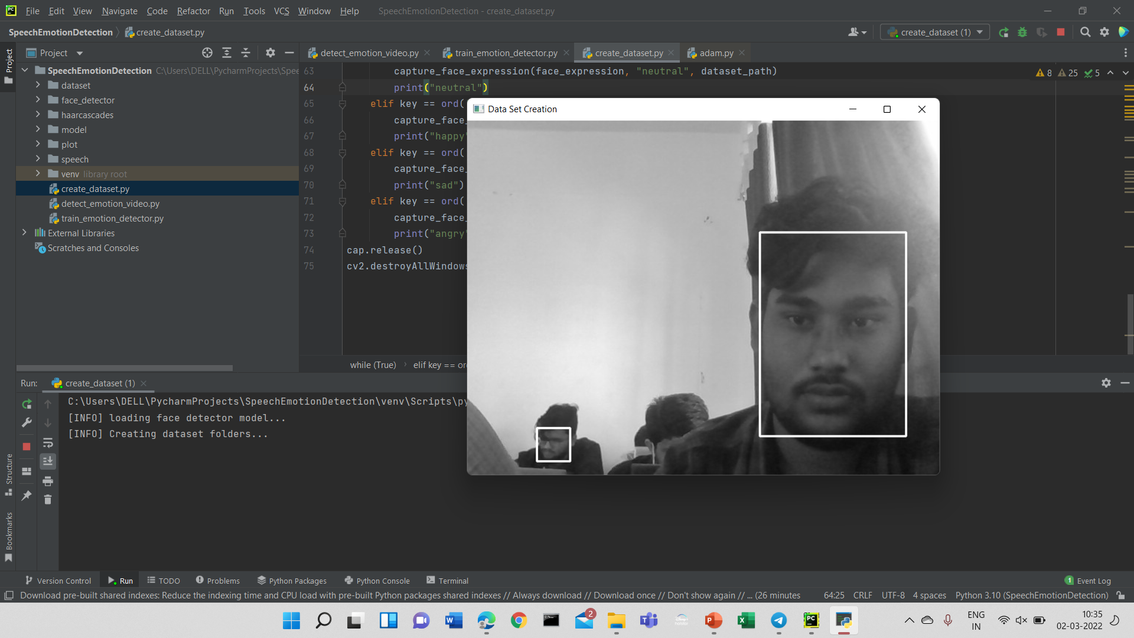
Output

Slide 10
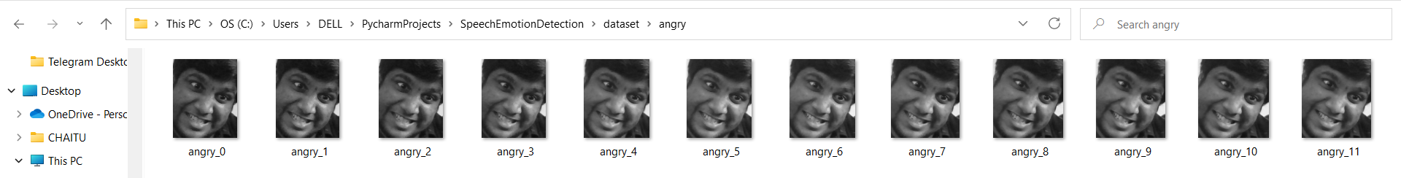
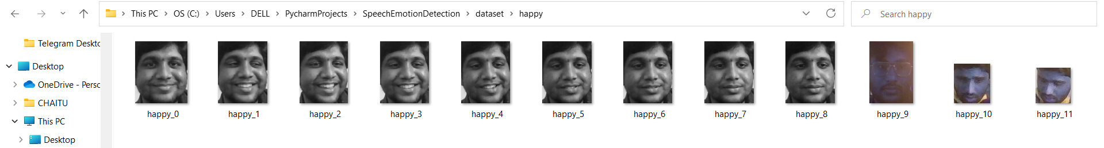
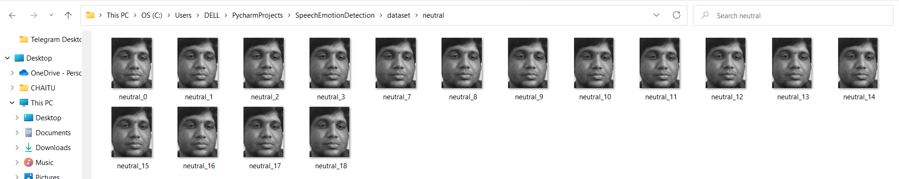


Slide 11
Conclusion
Through this project, we will show how we can leverage MLP Classifier to obtain the underlying emotion from speech audio data and some insights on the human expression of emotion through voice. This system can be employed in a variety of setups like Call Centre for complaints or marketing, in voice-based virtual assistants or chatbots, in linguistic research, etc.

